Slide 1
MATHEMATICS BEHIND EIGENVECTORS AND EIGENVALUES

Slide 2
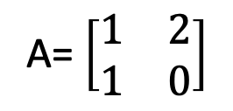
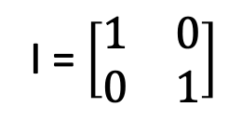
CALCULATING EIGENVECTORS
A= $\left[\begin{matrix}1 & 2 \\ 1 & 0\end{matrix}\right]$
Aν = λν
Aν = λIν
Aν - λIν = 0
(A - λI) ν = 0
Multiply RHS by Identity Matrix
I = $\left[\begin{matrix}1 & 0 \\ 0 & 1\end{matrix}\right]$
Move all terms to LHS so that
RHS represents zero vector
Pull out ν from two terms on LHS
Notes:
To calculate the two eigenvectors of matrix A, let’s multiply the right and side of the equation by identity matrix I, with same number of rows and columns as matrix A so that we have a two-by-two matrix on both sides. Then, we move all terms to the left-hand side in the equation. Right hand side represents. A zero vector. Then we pull out ν from the two terms on left hand side.
RHS = right hand side
LHS = left hand side

Slide 3

CALCULATING EIGENVECTORS
(A - λI) ν = 0
(A - λI)⁻¹ (A - λI)ν = 0 (A - λI)⁻¹
To isolate ν, imagine multiply inverse of matrix on both sides
Therefore,
ν = 0
Trivial Solution
But eigenvector should be a non-zero vector. Thus,
(A - λI)⁻¹ (A - λI)ν = 0 (A - λI)⁻¹
Inverse of matrix (A - λI),
which is (A - λI)⁻¹does not exist
And if determinant of a matrix is zero, then inverse of that matrix does not exists. So,
det |A - λI| = 0
Notes:
To isolate the vector ν on the left-hand side, imagine that we then would multiply by the inverse of the matrix on both sides so that, vector ν is equal to the zero vector, which is trivial solution. However, an eigenvector should be a non-zero vector. Thus, we like to find a solution where this matrix is not invertible, which means no inverse of this matrix should exist. And if determinant of a matrix is zero, then we can not calculate its inverse. So, determinant if this matrix is zero.

Slide 4
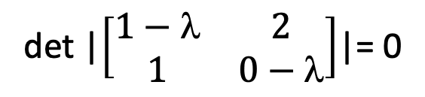
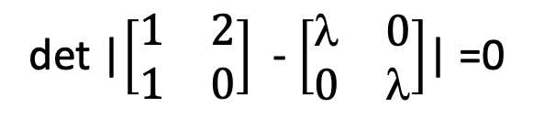
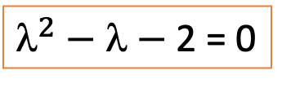
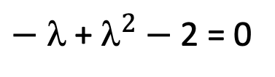
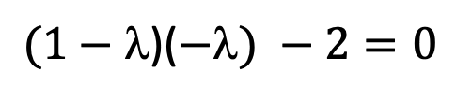
CALCULATING EIGENVALUES
det |A - λI| = 0
det |$\left[\begin{matrix}1 & 2 \\ 1 & 0\end{matrix}\right]$ - $\left[\begin{matrix} & 0 \\ 0 & \end{matrix}\right]$| =0
Putting values
det |$\left[\begin{matrix}1−λ & 2 \\ 1 & 0−λ\end{matrix}\right]$|= 0
Solving determinant
$(1−$)($−) −2=0$
$− $ + $^{2}$ $−$2 = 0
$^{2}$ $− $ $−$2 = 0

Slide 5
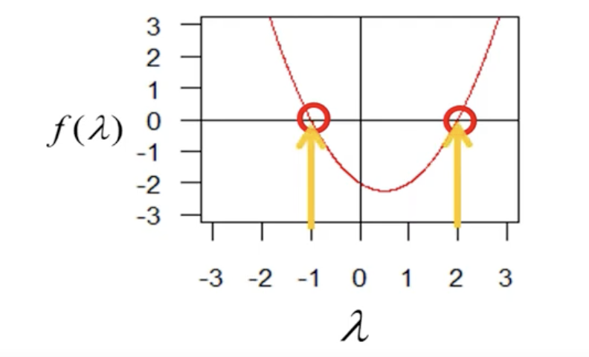
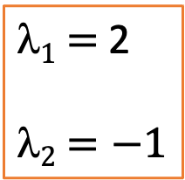
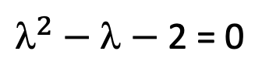
CALCULATING EIGENVALUES
$^{2}$ $− $ $−$2 = 0
On solving above equation, we get
$1$ $=$2
$2$ $=−1$
Notes:
If we plot how the left-hand side changes as a function of lambda, we get the following plot, where we can see that the function is equal to zero if lambda is set to either negative one or two

Slide 6
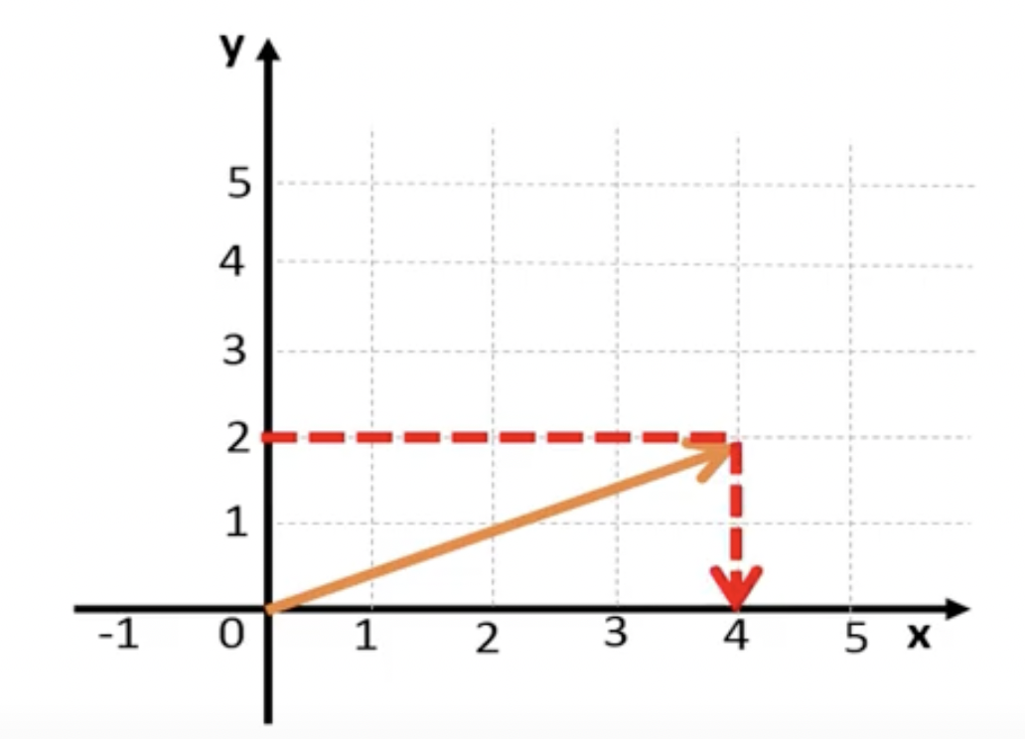
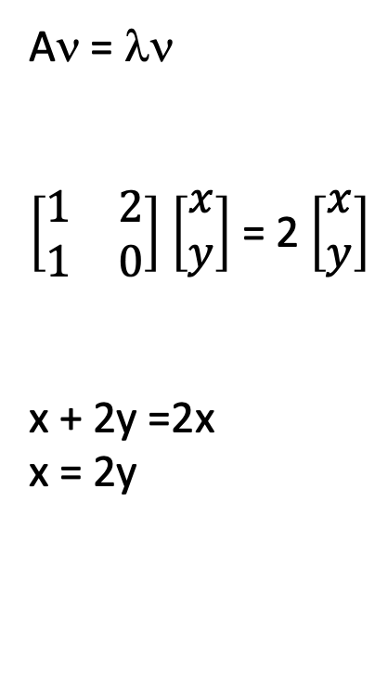

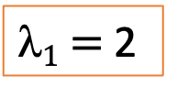
CALCULATING EIGENVECTORS
$1$ $=$2
Aν = λν
$\left[\begin{matrix}1 & 2 \\ 1 & 0\end{matrix}\right]$ $\left[\begin{matrix}x \\ y\end{matrix}\right]$ = 2 $\left[\begin{matrix}x \\ y\end{matrix}\right]$
x + 2y =2x
x = 2y
Putting values
2y =x
x = 2y
For every 1 unit increase in y, x increases by 2 units.
Thus,
ν₁ = $\left[\begin{matrix}4 \\ 2\end{matrix}\right]$
Eigenvector of Matrix A
Notes:
After calculating eigenvalues, let’s calculate eigenvectors of matrix A. First, we calculate the eigenvector with the corresponding eigenvalue of two. Substitute lambda by two. Substituting the values of matrices in the equation and solve it. We will get two equations.

Slide 7
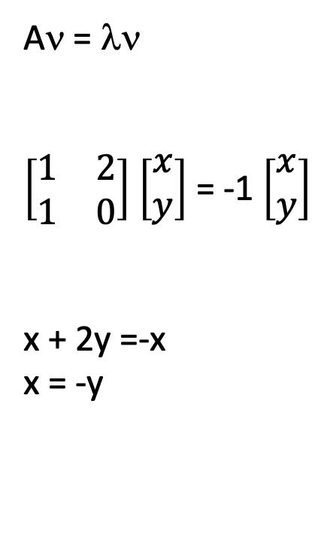
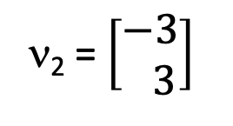

CALCULATING EIGENVECTORS
$2$ $=−1$
Aν = λν
$\left[\begin{matrix}1 & 2 \\ 1 & 0\end{matrix}\right]$ $\left[\begin{matrix}x \\ y\end{matrix}\right]$ = -1 $\left[\begin{matrix}x \\ y\end{matrix}\right]$
x + 2y =-x
x = -y
Putting values
y = -x
x = -y
For every 1 unit increase in y, x reduces by 1 units.
Thus,
ν₂ = $\left[\begin{matrix}−3 \\ 3\end{matrix}\right]$
Eigenvector of Matrix A
Notes:
Performing the same calculations with eigenvalue=-1.

Slide 8
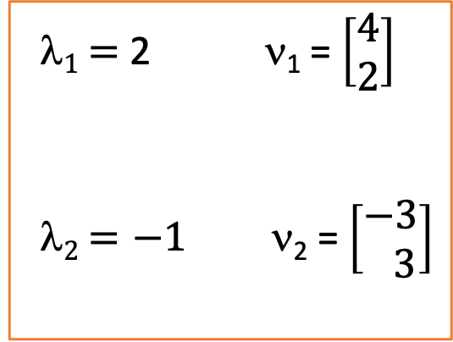
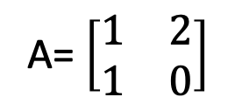
EIGENVALUES AND EIGENVECTORS
Aν = λν
A= $\left[\begin{matrix}1 & 2 \\ 1 & 0\end{matrix}\right]$
$1$ $=$2 ν₁ = $\left[\begin{matrix}4 \\ 2\end{matrix}\right]$
$2$ $=−1$ ν₂ = $\left[\begin{matrix}−3 \\ 3\end{matrix}\right]$
Two eigenvalues with their corresponding eigenvectors of matrix A

Slide 9
REFERENCE
https://www.youtube.com/watch?v=JtcNe--fsyA&t=437s
THANK YOU

